Slide 1
Linear Models

Slide 2
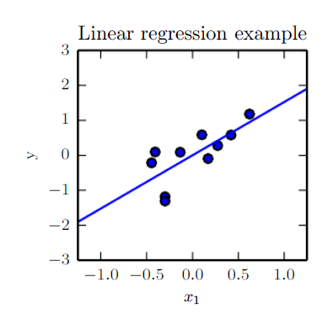




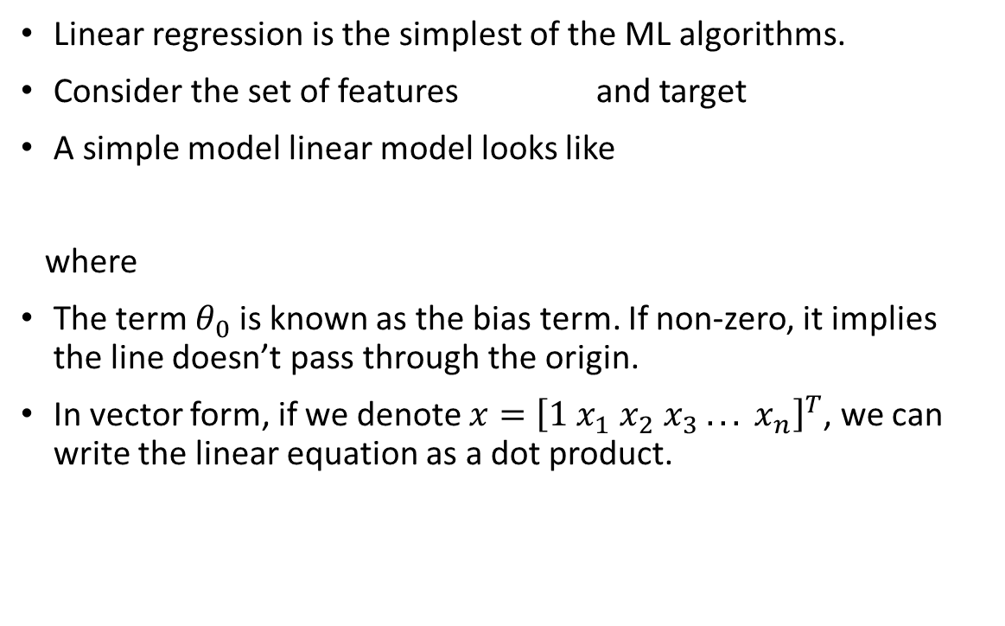
Linear Models
Linear regression is the simplest of the ML algorithms.
Consider the set of features and target
A simple model linear model looks like
where
The term $θ_{0}$ is known as the bias term. If non-zero, it implies the line doesn’t pass through the origin.
In vector form, if we denote $x={\left[1 x_{1} x_{2} x_{3} . . . x_{n}\right]}^{T}$, we can write the linear equation as a dot product.

Slide 3
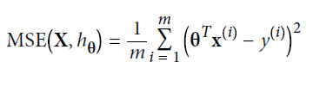

Linear Models.
How do we know our model is good? The Mean Squared Error on the test set must be low.
We achieve this by minimizing the MSE (cost function) on the training set and hope it generalizes to the test set.
This has a closed form solution called the normal equations.
Notice there is a matrix inversion. For very large training data, this is computationally very expensive.

Slide 4
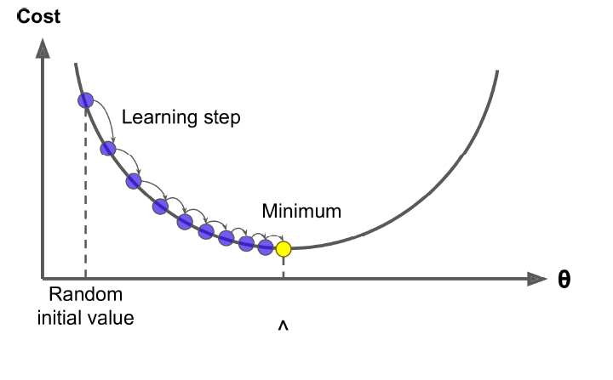

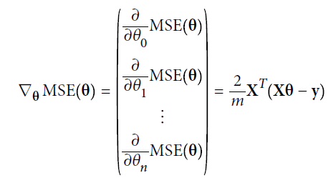

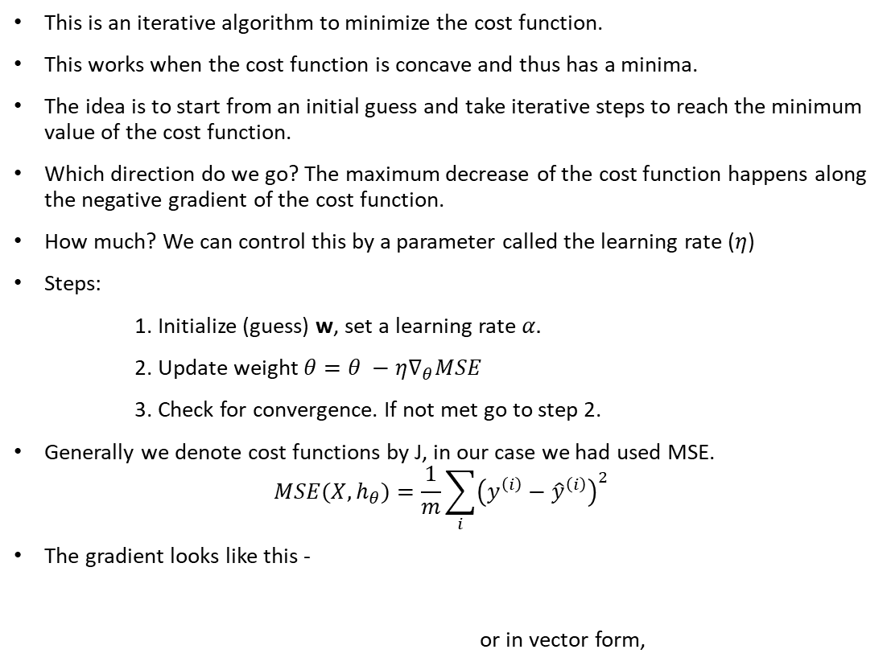
Gradient Descent
This is an iterative algorithm to minimize the cost function.
This works when the cost function is concave and thus has a minima.
The idea is to start from an initial guess and take iterative steps to reach the minimum value of the cost function.
Which direction do we go? The maximum decrease of the cost function happens along the negative gradient of the cost function.
How much? We can control this by a parameter called the learning rate ($η$)
Steps:
1. Initialize (guess) w, set a learning rate $α.$
2. Update weight $θ=θ −η∇_{θ}MSE$
3. Check for convergence. If not met go to step 2.
Generally we denote cost functions by J, in our case we had used MSE.
$$MSE(X, h_{θ})=\frac{1}{m}\sum_{i}{{\left(y^{\left(i\right)}−{\hat{y}}^{\left(i\right)}\right)}^{2}}$$
The gradient looks like this -
or in vector form,

Slide 5
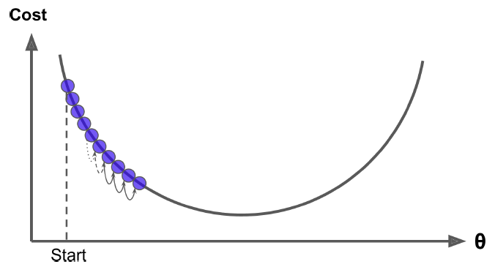
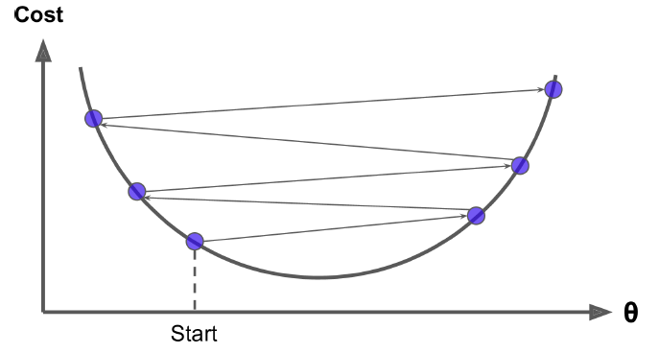
Gradient Descent
Learning Rate too small – Takes long time
Learning Rate too high – too unstable. We may never hit the minima.

Slide 6
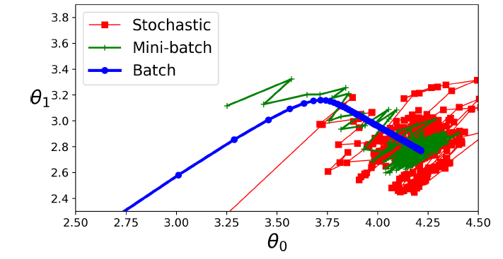
Gradient Descent
There are 3 ways to do GD
Batch GD: Using the vector form, we compute gradient for full data in one shot and update weights every iteration
Mini-batch GD: Here we pick up a random subset of the data and use it for the weight update each iteration
Stochastic GD: This picks only one random instance to update weights each iteration.

Slide 7
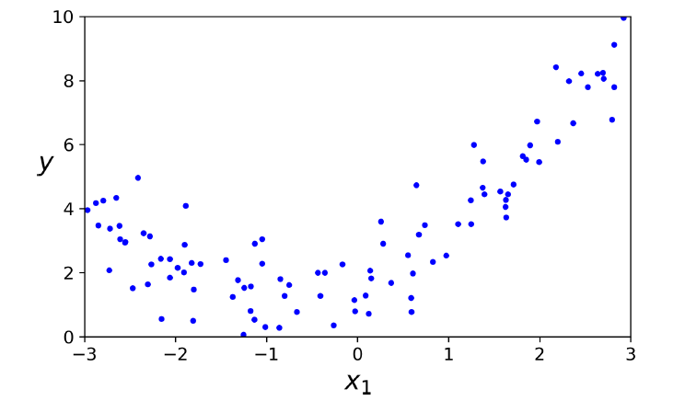
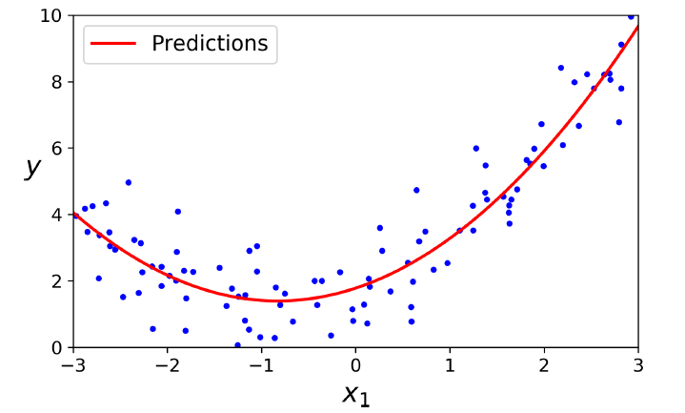
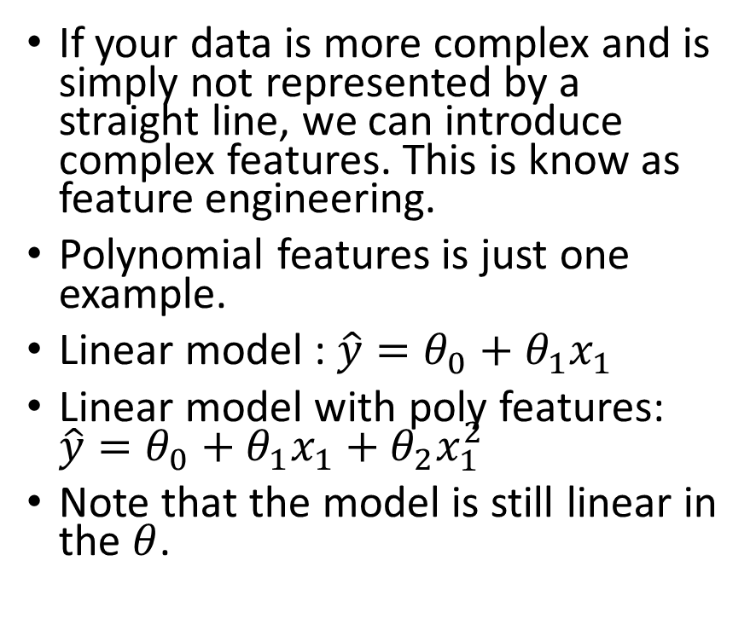
Polynomial Features
If your data is more complex and is simply not represented by a straight line, we can introduce complex features. This is know as feature engineering.
Polynomial features is just one example.
Linear model : $\hat{y}=θ_{0}+θ_{1}x_{1}$
Linear model with poly features: $\hat{y}=θ_{0}+θ_{1}x_{1}+θ_{2}x_{1}^{2}$
Note that the model is still linear in the $θ$.

Slide 8
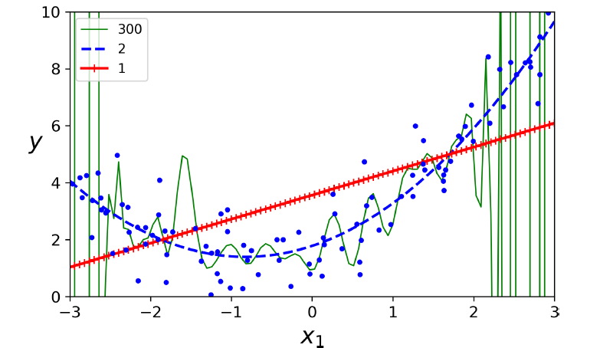
Polynomial Features
We will not know the degree of the polynomial to choose beforehand.
If it is too low, the model will not be accurate on the training data itself. This is called underfitting.
If it is too high, the model will fit well on the training data but does not generalize better to test data. This is called overfitting.
Both overfitting and underfitting are bad and does not give you good performance.

Slide 9
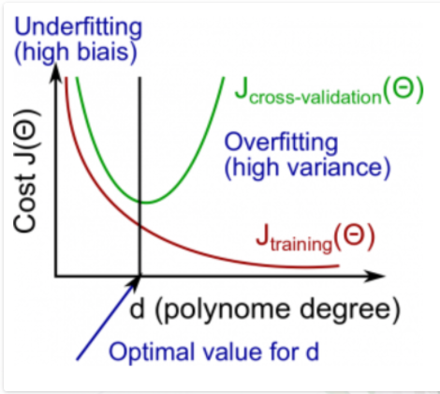
Overfit/Underfit
In general, we decide whether a model is overfitting or underfitting based on it’s complexity. Previously we saw degree of polynomial decide the model complexity.
We define the gap between the validation error and training error as the generalization error. It is desired to be less.
Generalization error is made of two components: bias and variance.
Bias : This part of the generalization error is due to wrong assumptions, such as assuming that the data is linear when it is actually quadratic. A high-bias model is most likely to underfit the training data
Variance: This part is due to the model’s excessive sensitivity to small variations in the training data. A model with many degrees of freedom (such as a high-degree polynomial model) is likely to have high variance, and thus to overfit the training data.
So a good model is a balance between the bias and variance which can be achieved by optimal model complexity.

Slide 10
Regularization
Regularization is a technique to reduce the degrees of freedom of a model to prevent overfitting.
Let’s revisit Linear regression. The weights are degrees of freedom for the model. Can we constrain it so that it doesn’t overfit?
There are two ideas to constraining the weights:
One way to limit the weights from having large values.
Another way is have sparse weights, i.e, not all weights are important.

Slide 11


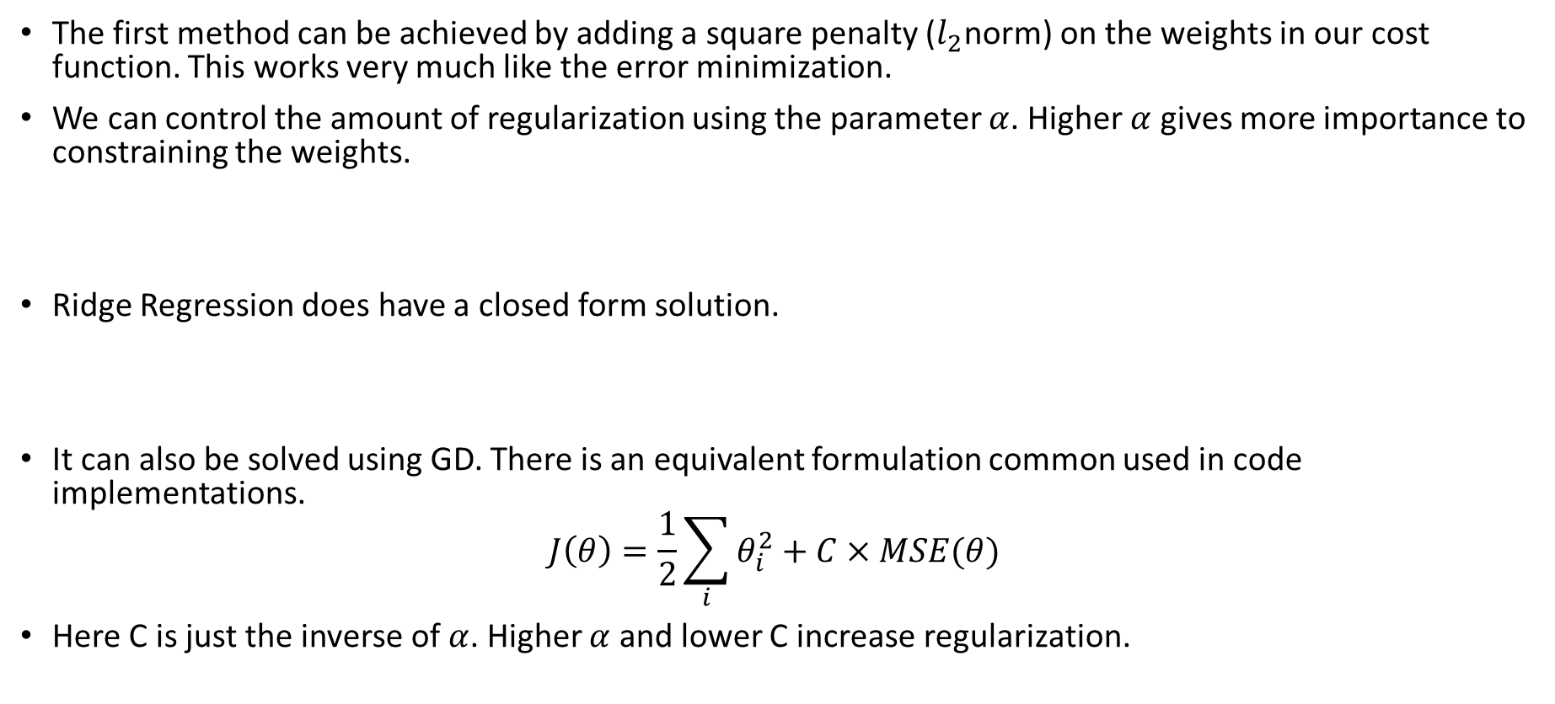
Ridge Regression
The first method can be achieved by adding a square penalty ($l_{2}$norm) on the weights in our cost function. This works very much like the error minimization.
We can control the amount of regularization using the parameter $α$. Higher $α$ gives more importance to constraining the weights.
Ridge Regression does have a closed form solution.
It can also be solved using GD. There is an equivalent formulation common used in code implementations.
$$J\left(θ\right)=\frac{1}{2}\sum_{i}{θ_{i}^{2}}+C×MSE(θ)$$
Here C is just the inverse of $α$. Higher $α$ and lower C increase regularization.

Slide 12

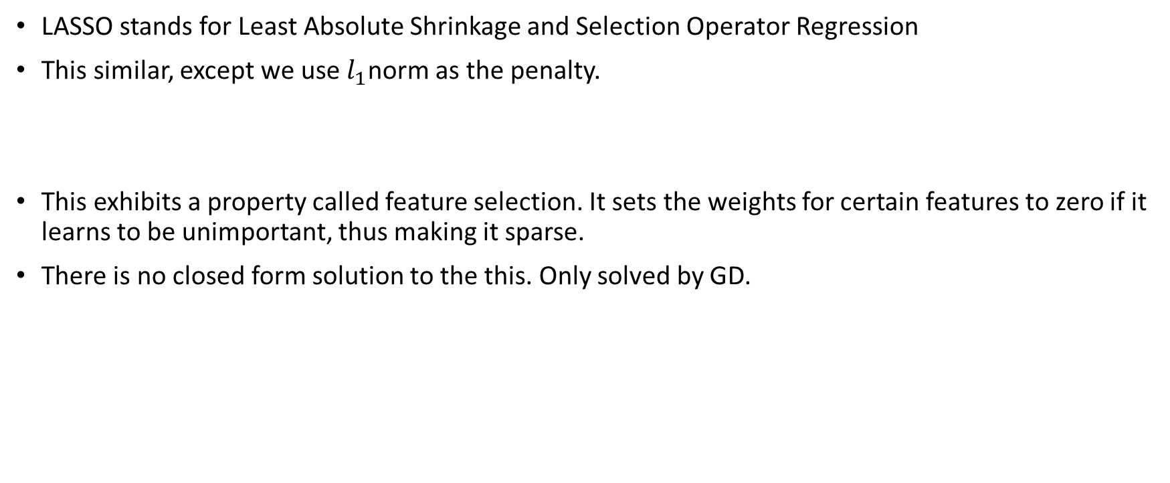
Lasso Regression
LASSO stands for Least Absolute Shrinkage and Selection Operator Regression
This similar, except we use $l_{1}$norm as the penalty.
This exhibits a property called feature selection. It sets the weights for certain features to zero if it learns to be unimportant, thus making it sparse.
There is no closed form solution to the this. Only solved by GD.

Slide 13

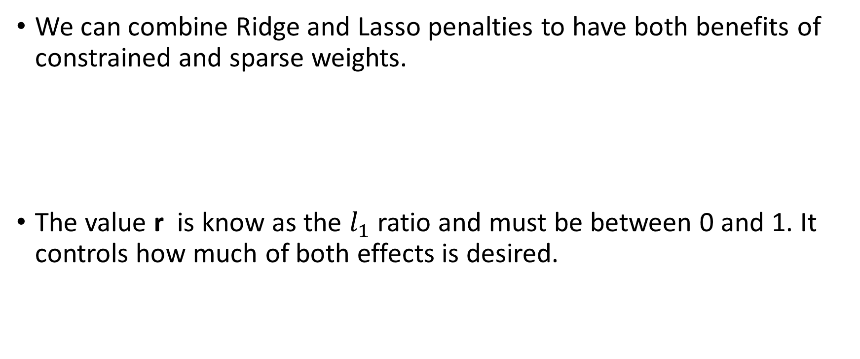
Elastic Net Regression
We can combine Ridge and Lasso penalties to have both benefits of constrained and sparse weights.
The value r is know as the $l_{1}$ ratio and must be between 0 and 1. It controls how much of both effects is desired.

